Slide 1


Frito lay
Samuel VonPaays Soh
03/2020

Slide 2

Top 3 Factors - TURNOVER
Age.
A parabola curve: Age between 20 and 30 has high turnover. Also the age of 50 and above.
Job role.
A total of 9 job roles for the company.
Sales representative position has the highest number of job turnover whereas research director has the lowest job turnover
Total working years.
Rookie year which is less than 10 of working years has high turnover and 10 and above working years have low and stable turnover.

Slide 3
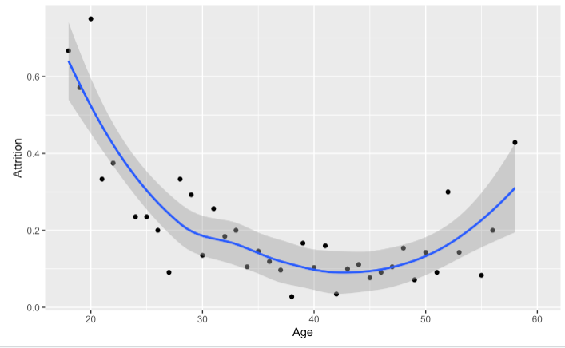

Plot of age vs attrition (%)

Slide 4
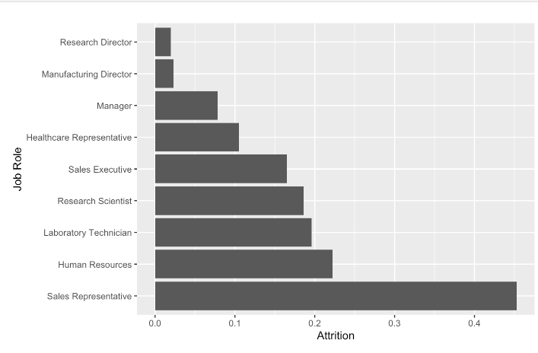
Bar plot of job role vs attrition (%)

Slide 5
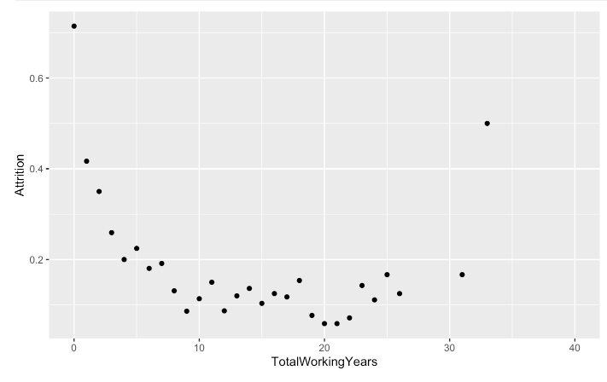
Plot of total working years vs turnover(%)

Slide 6
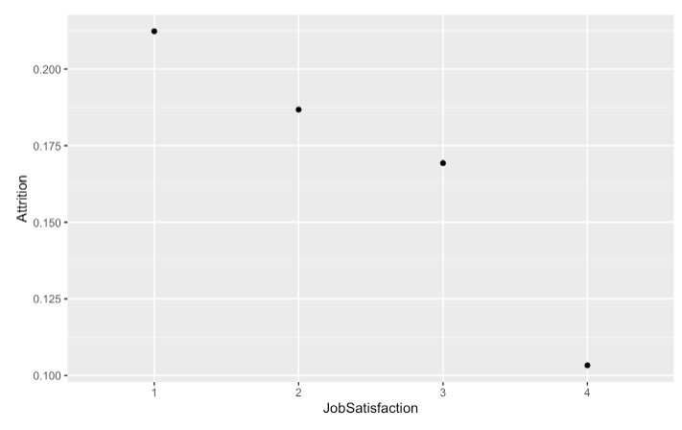
Job satisfaction level 4 is the best job satisfaction which has lowest turnover

Slide 7
Attrition Model Prediction
Choosen variables: Age, Job Role, Job Satisfaction, and Overtime.
Naïve Bayes model result:
Accuracy = 0.85
Sensitivity = 0.86
Specificity = 0.69
KNN model result:
Accuracy = 0.84
Sensitivity = 0.85
Specificity = 0.50
Comparing the above 2 models, Naïve Bayes clear a winner due to the desired target of both sensitivity and specificity > 60%

Slide 8
Salary Model Prediction
Chosen variables: Monthly Income vs (Job Level and Total Working Years)
Linear model fit result:
Salary → RMSE = $1,245 which less than desired target of $3,000.

Slide 9

My Github Link
https://github.com/svonpaayssoh/CaseStudy2DDS

Slide 10
YouTube
Youtube link: https://youtu.be/LkNJi_d724g

